Slide 1

Part I - JOINS
Mohit Goel

Slide 2
JOINS
JOINS allow us to combine information from multiple sources.
Section overview:
Creating an alias with the AS clause.
Understanding different kinds of JOINs.
INNER JOINS
OUTER JOINS
FULL JOINS
UNIONS

Slide 3
AS Statement
AS allows us to create an alias for a column or result.
Syntax for AS statement:
SELECT column_name AS new_column_name
FROM table_name;
We may also use this on functions. For instance:
SELECT SUM(column_name) AS new_column_name
FROM table_name;
The AS operator gets executed at the very end of a query. This means we cannot use the alias inside a WHERE or HAVING operator. The example on slide 7 illustrates this.

Slide 4
AS Statement
Exercise: Output the number of transactions that took place and name the output column “no_transactions”.
Hint: Use the payment table.
Query:
SELECT COUNT(*) AS no_transactions
FROM payment;

Slide 5
AS Statement
Exercise: Output the total spend per customer ID and name the output column “total_spend”.
Hint: Use GROUP BY
Query:
SELECT customer_id, SUM(amount) AS total_spend
FROM payment
GROUP BY customer_id;

Slide 6
AS Statement
Exercise: Output the total spend per customer ID of which are over £100, and name the output column “total_spend”.
Query:
SELECT customer_id, SUM(amount) AS total_spend
FROM payment
GROUP BY customer_id
HAVING SUM(amount) > 100;

Slide 7
AS Statement
Note: The below query will yield an error as the AS operator gets executed at the end of the query.
SELECT customer_id, SUM(amount) AS total_spend
FROM payment
GROUP BY customer_id
HAVING total_spend > 100;
The HAVING clause does not recognise total_spend > 100 as the alias has not been executed.

Slide 8
INNER JOINS
INNER JOIN is the simplest JOIN type.
JOINs allow us to combine multiple tables together.
Different JOIN types exist to give us the freedom to deal with the information that is present in one of the joined tables.
An INNER JOIN is a type of join that returns all the rows from both participating tables where the key record of one table is equal to the key record of another table.

Slide 9
INNER JOINS
An INNER JOIN will result with the set of records that match in both tables.
We notice that the “Colour” columns have repeated themselves in the “Result” table. We will address how to eliminate this in slide 11.

Slide 10
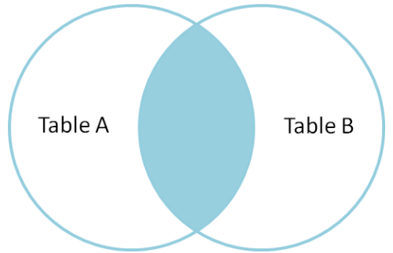
INNER JOINS
Syntax of INNER JOIN.
SELECT * FROM TableA
INNER JOIN TableB
ON TableA.Column_name_X = TableB.Column_name_X
Column_name_X are the columns that exist and match in both tables.

Slide 11
INNER JOINS
When performing an INNER JOIN, for instance, the “Result” table we observed on slide 9, we noticed there was a repeating column.
The column that is common to both tables will be repeated in the output table.
To overcome this, we may specify the columns we wish to see.

Slide 12
INNER JOINS
SELECT fruit, vegetable, fruitbasket.colour
FROM fruitbasket
INNER JOIN vegetabledrawer
ON fruitbasket.colour = vegetabledrawer.colour

Slide 13
INNER JOINS
In the previous example, we specified the tablename and column name “fruitbasket.colour” as the column name “colour” was common to both tables.
However, we did not need to specify the table names for the other columns “fruit” and “vegetable” as they were unique to their own tables.
Note: The table order does not matter in an INNER JOIN.
Note: If we see just JOIN without anything else such as INNER, SQL will treat is as an INNER JOIN.

Slide 14
INNER JOINS
Exercise: Output the table which contains the payment_id, customer_id, first_name and second_name of our customers.
Hint: Use the payment and customer tables.
Hint: customer_id is the column that is common to both.
Query:
SELECT payment_id, payment.customer_id, first_name, last_name
FROM payment
INNER JOIN customer
ON payment.customer_id = customer.customer_id;

Slide 15
OUTER JOINS
OUTER JOINs allow us to specify how to deal with values only present in one of the tables being joined.
These JOINs are slightly different, however, require no more time to learn as the INNER JOIN.
We will discuss the following types of OUTER JOINs:
FULL OUTER JOIN
LEFT OUTER JOIN
RIGHT OUTER JOIN

Slide 16
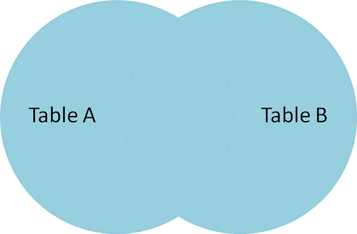
Full OUTER JOINS
FULL OUTER JOIN produces the set of all records in Table A and Table B, with matching records from both sides where available. If there is no match, the missing side will contain null values.

Slide 17
Full OUTER JOINS
Syntax for FULL OUTER JOIN:
SELECT * FROM TableA
FULL OUTER JOIN TableB
ON TableA.Column_name_X = TableB.Column_name_X
Column_name_X are the columns that exist and match in both tables.

Slide 18
FULL OUTER JOIN with WHERE
FULL OUTER JOIN with WHERE retrieves the rows that are unique to either table.
In essence, this is the opposite of an INNER JOIN.
SELECT * FROM TableA
FULL OUTER JOIN TableB
ON TableA.Column_name_X = TableB.Column_name_X
WHERE TableA.column_a IS null OR
TableB.column_b IS null;
In the above, we are searching for where the column from TableA or TableB is null. We are therefore compiling all the data that does not match between the tables.
Note: WHERE comes at the end of the query.

Slide 19
FULL OUTER JOIN with WHERE
Exercise: Business Task.
There has been a new privacy policy that has been implemented to ensure we do not have any unnecessary customer data. The policy states that we should not have any data from any customer that has not made a payment.
In essence, we wish to make sure that all the payments are associated with our current customers, and our current customers are associated with historic payments. We therefore cannot have customer information that has not made any transactions with us. This goes for all the rental stores across all areas.
Hint: Use the customer and payment tables.
Hint: Use the FULL OUTER JOIN using the customer_id column.

Slide 20
FULL OUTER JOIN with WHERE
Exercise: Business Task.
Query:
SELECT * FROM customer
FULL OUTER JOIN payment
ON customer.customer_id = payment.customer_id
WHERE customer.customer_id IS null
OR payment.payment_id IS null;

Slide 21
FULL OUTER JOIN with WHERE
Exercise: Business Task.
Is there any other way we can validate the previous exercise? Even if our method gives an indication and may not provide concrete evidence?
Hint: Compare the data of the customer and payment tables to compare the different customer types in each.
Solution: There are 599 distinct entries in both tables, which indicates that we do not have any customer data of which did not make transactions.
Queries:
SELECT COUNT(DISTINCT(customer_id)) FROM payment;
SELECT COUNT(DISTINCT(customer_id)) FROM customer;

Slide 22
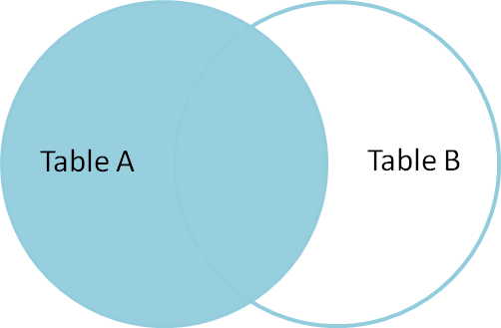
LEFT OUTER JOIN
LEFT OUTER JOIN produces a complete set of records from Table A, with the matching records (where available) in Table B. If there is no match, the right side will contain null.
Syntax for LEFT OUTER JOIN:
SELECT * FROM TableA
LEFT OUTER JOIN TableB
ON TableA.Column_name_X = TableB.Column_name_X

Slide 23
LEFT OUTER JOIN
Note: As our join is no longer symmetrical, the order of the tables in the query matters.
Note: If there are data rows that only exist in Table B, they will not be returned as they must match Table A. Therefore, we return nothing that is exclusive to Table B.
The LEFT OUTER JOIN can be shortened to just LEFT JOIN in the SQL syntax.

Slide 24
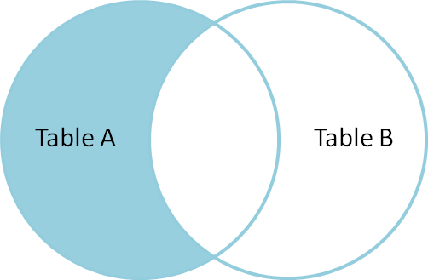
LEFT OUTER JOIN with WHERE
To produce the set of records only in Table A, but not in Table B, we perform the same LEFT OUTER JOIN, then exclude the records we don't want from the right side via a WHERE clause.
Syntax of LEFT OUTER JOIN with WHERE:
SELECT * FROM TableA
LEFT OUTER JOIN TableB
ON TableA.Column_name_X = TableB.Column_name_X
WHERE TableB.column_b IS null

Slide 25
LEFT OUTER JOIN with WHERE
To produce the set of records only in Table A, but not in Table B, we perform the same LEFT OUTER JOIN, then exclude the records we don't want from the right side via a WHERE clause.
Another way to think of the above is to output Table A but remove any data from Table A that is also common or included in Table B.
And this is as complex as it gets! This is deemed complex as it is a non-symmetric join.

Slide 26
LEFT OUTER JOIN
Exercise: Business Task
What films do we not currently have in any of our stores?
Hint: Use LEFT OUTER JOIN with WHERE.
Query:
SELECT film.film_id, title, inventory_id, store_id
FROM film
LEFT OUTER JOIN inventory
ON inventory.film_id = film.film_id
WHERE inventory.film_id IS null;

Slide 27
LEFT OUTER JOIN
Exercise: Business Task
What films do we not currently have in any of our stores?
Hint: Start by comparing the number of films we have in the film table in comparison to the inventory table.
Hint: There are 42 movie titles not in our inventory. We use the below queries to acknowledge this:
SELECT COUNT(DISTINCT(film_id)) FROM film;
SELECT COUNT(DISTINCT(film_id)) FROM inventory;

Slide 28
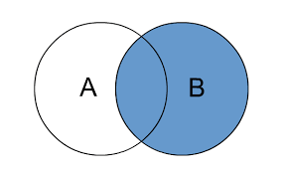
RIGHT JOIN
A RIGHT JOIN is essentially the same as a LEFT JOIN, except that the table order is switched.
In other words, this is equivalent to switching the table order in a LEFT JOIN.
This is because, like the LEFT JOIN, the RIGHT JOIN is not symmetric.

Slide 29
RIGHT JOIN
RIGHT OUTER JOIN produces a complete set of records from Table B, with the matching records (where available) in Table A. If there is no match, the right side will contain null.
Syntax for RIGHT OUTER JOIN:
SELECT * FROM TableA
RIGHT OUTER JOIN TableB
ON TableA.Column_name_X = TableB.Column_name_X

Slide 30

RIGHT OUTER JOIN with WHERE
To produce the set of records only in Table B, but not in Table A, we perform the same LEFT OUTER JOIN, then exclude the records we don't want from the right side via a WHERE clause.
Syntax of LEFT OUTER JOIN with WHERE:
SELECT * FROM TableA
RIGHT OUTER JOIN TableB
ON TableA.Column_name_X = TableB.Column_name_X
WHERE TableB.column_b IS null;

Slide 31
UNION
The UNION operator is used to combine the result-set of two or more SELECT statements.
It serves to directly concatenate two results together, essentially “pasting” them together.
Syntax for UNION:
SELECT column_names FROM table1
UNION
SELECT column_names FROM table2;

Slide 32
JOIN Exercises
Exercise: Business Task
The California sales tax laws have changed and we need to alert our customers via email. Find the emails of the customers who live in California.
Hint: Use the address and customer tables.
Hint: Look at the district column.
Query:
SELECT district, email FROM address
LEFT JOIN customer
ON address.address_id = customer.address_id
WHERE district = 'California';

Slide 33
JOIN Exercises
Exercise: Business Task
A customer wishes to see which movies have the actor Nick Wahlberg. Find the list so we can inform the customer. Output the table with three columns: “title”, “first_name” and “last_name”.
Hint: We are not required to perform 2 JOINS. Please use google for hints.
Hint: We are using the following tables: actor, film and film_actor.

Slide 34
JOIN Exercises
Solution 1:
SELECT title, first_name, last_name FROM film
LEFT JOIN film_actor
ON film.film_id = film_actor.film_id
LEFT JOIN actor
ON actor.actor_id = film_actor.actor_id
WHERE film_actor.actor_id = 2;

Slide 35
JOIN Exercises
Solution 2:
SELECT title, first_name, last_name FROM film_actor
INNER JOIN film
ON film.film_id = film_actor.film_id
INNER JOIN actor
ON actor.actor_id = film_actor.actor_id
WHERE actor.actor_id = 2;

Slide 36
JOIN Exercises
Solution 3:
SELECT title, first_name, last_name FROM film_actor
INNER JOIN actor
ON film_actor.actor_id = actor.actor_id
INNER JOIN film
ON film_actor.film_id = film.film_id
WHERE first_name = 'Nick'
AND last_name = 'Wahlberg';

Slide 37

End Of Section

